Slide 1

Marine AFC Fan satisfaction survey 2025
Held 29/04/2025 – 05/05/2025

Slide 2
Responses in detail
Age, Location, Average Games, Type of Fan

Slide 3
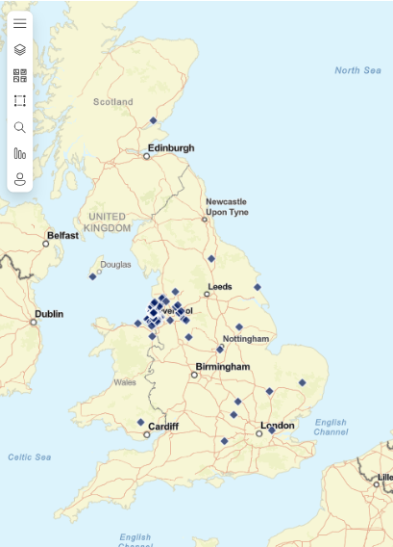
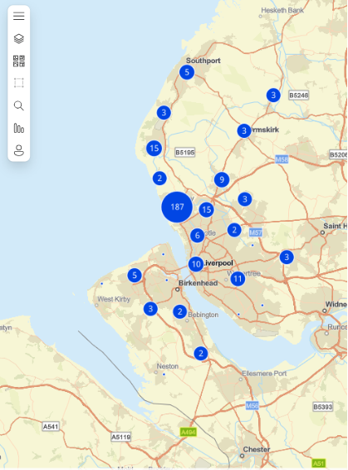
RESPONSE Breakdown
359 fans responded to the online survey. The average fan was based in Crosby and in the 45-55 bracket however there were some interesting additional points such as:
54 respondents from outside of Merseyside – only 3 of which were fans of away teams.
187 respondents from local to the Crosby area but a much wider spread of fans than potentially expected.
37% of respondents were Marine Season Ticket or Flexi Ticket Holders.

Slide 4
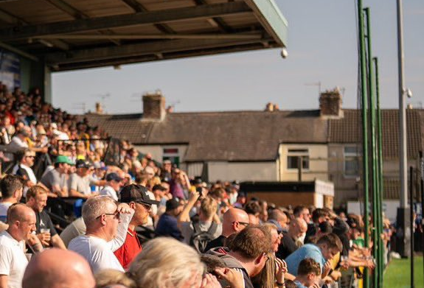
Satisfaction Scores - General

Slide 5
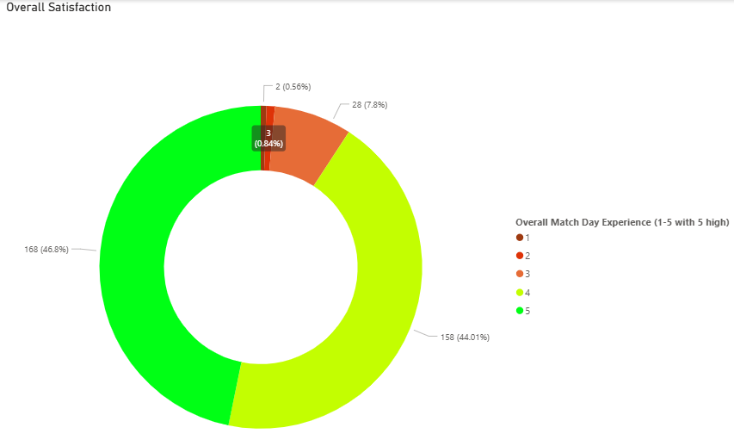
Overall satisfaction
91% of respondents were satisfied overall with the matchday experience.
The most satisfied age bracket was 55-64 with 95%.
The least satisfied age bracket was 35-44 with 89%.

Slide 6
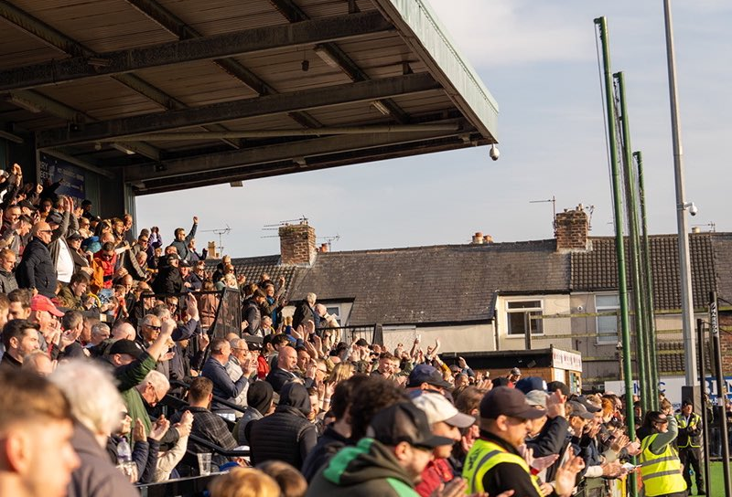
Satisfaction Scores - Specific

Slide 7
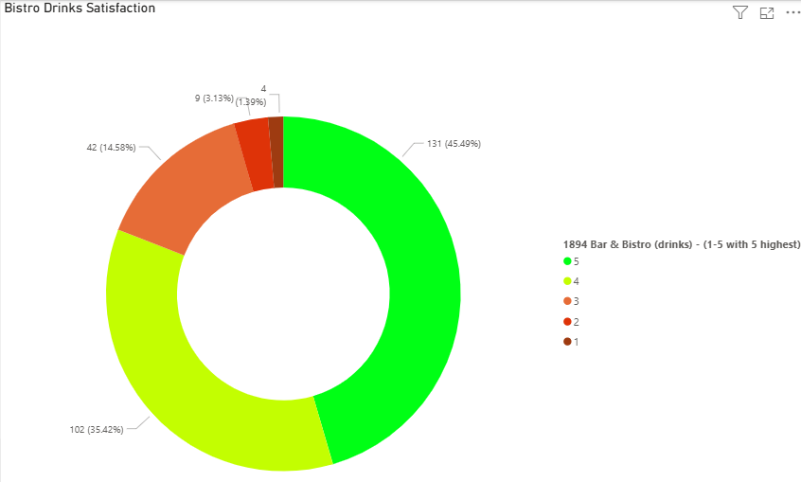
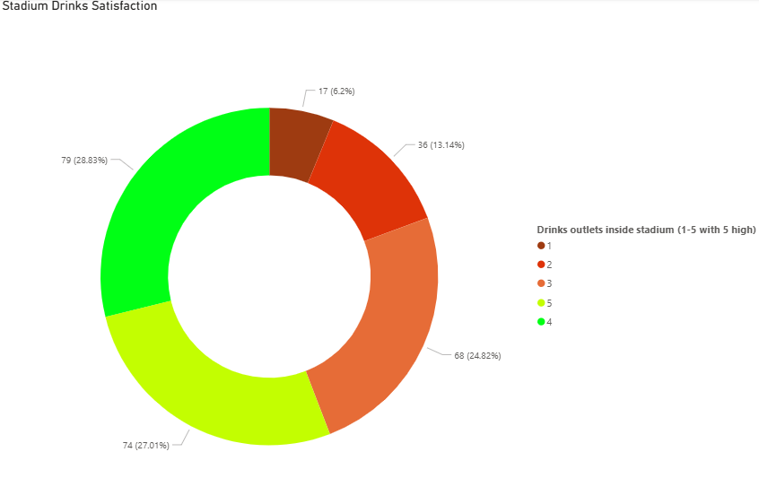
Drinks satisfaction
The difference in satisfaction with the drinks service from bistro to stadium is telling.
1894 Bar & Bistro
Inside the MTA
Satisfaction with the drinks service in the Bar & Bistro is 81%.
Satisfaction with the drinks service inside the stadium drops to 56%.

Slide 8
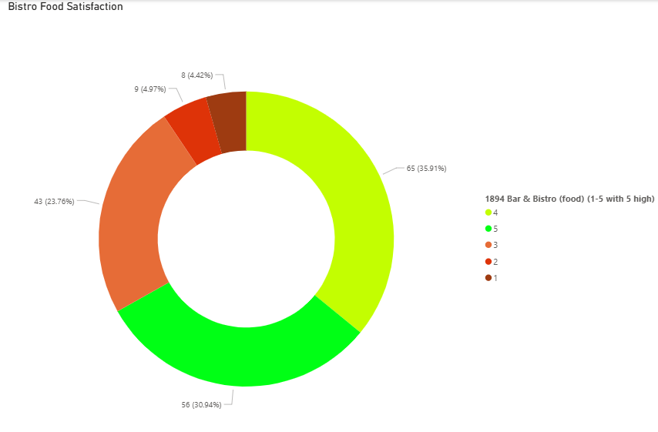
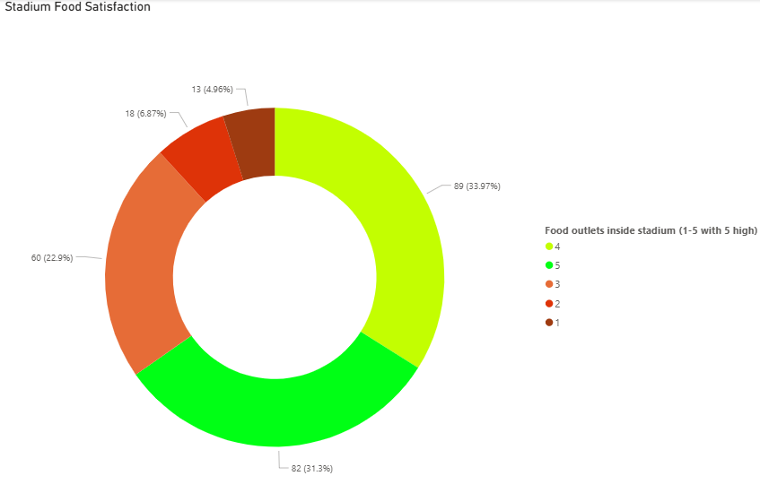
Food satisfaction
The difference in satisfaction with the food service from bistro and stadium is lower overall than with the drinks service.
1894 Bar & Bistro
Inside the MTA
Satisfaction with the food service in the Bar & Bistro is 67%.
Satisfaction with the drinks service inside the stadium drops slightly to 65%.

Slide 9
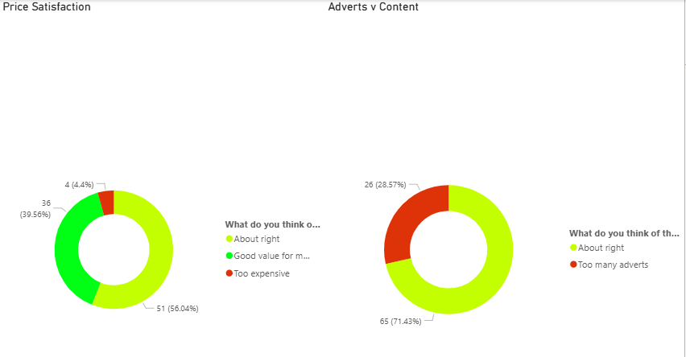
Programme satisfaction
Respondents were satisfied with the price of the programme, but a larger percentage felt it contained too many adverts.
Price
Content
Satisfaction with the price of the programme sold at the MTA is 96%.
However, 29% of respondents believe there are too many adverts inside.

Slide 10
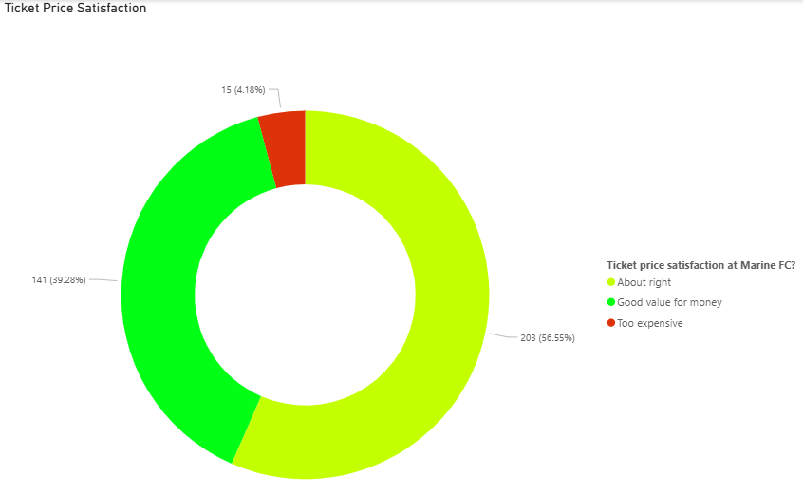
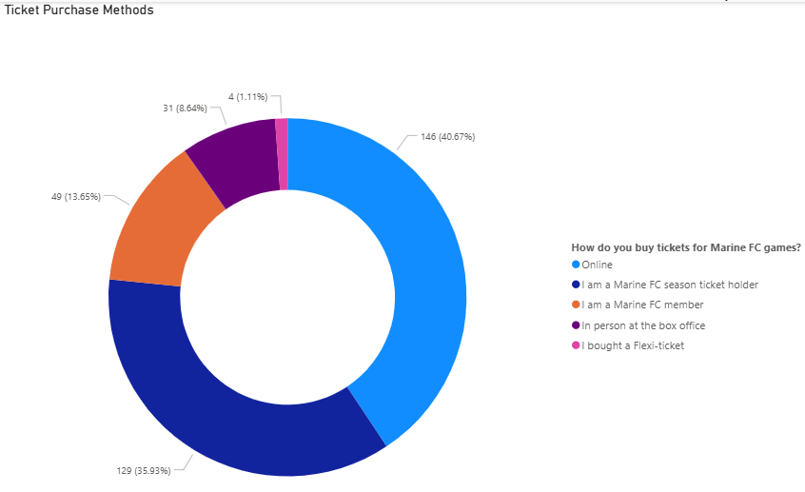
Ticket Price satisfaction
Respondents were overwhelmingly positive about the current ticket pricing at Marine.
Price
Purchasing Methods
Satisfaction with the price of ticketing at the MTA is 96%.
Only 9% of respondents buy tickets in person at the box office.

Slide 11
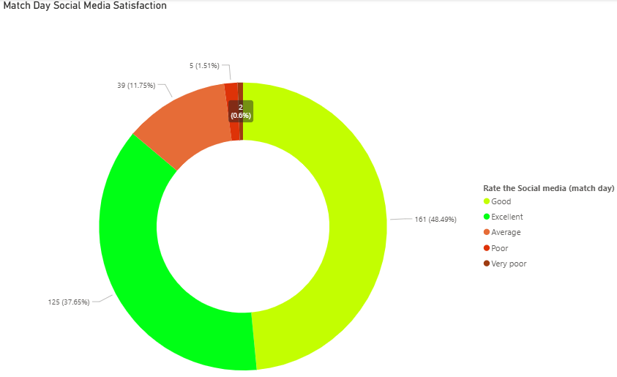
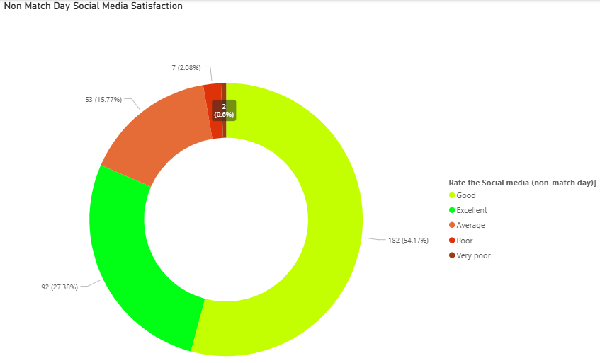
Social media satisfaction
The social media content published by the teams is generally well received by respondents with a preference for match day content.
Match Day
Non-Match Day
Satisfaction with the social media service on match days is 86%.
Satisfaction with the social media service drops slightly on non-match days to 82%.

Slide 12
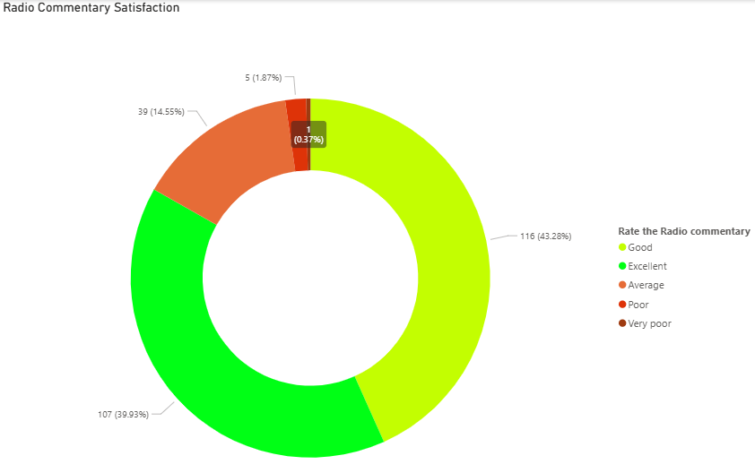
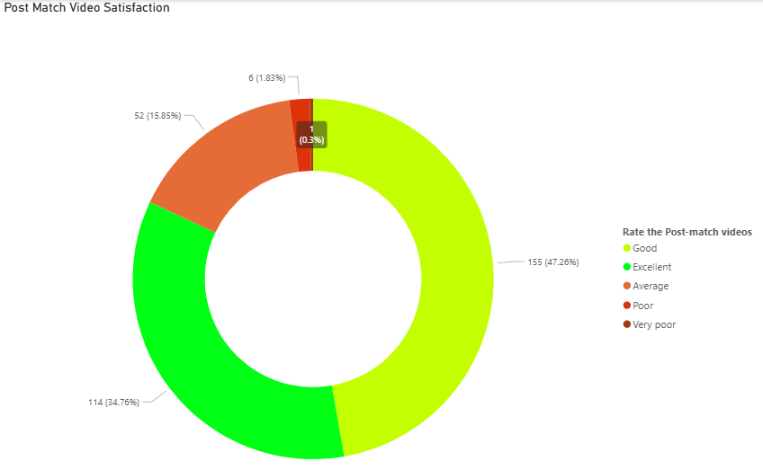
Match Day media satisfaction
The match day social media content published by the teams is generally well received with respondents equal fans of both.
Radio Commentary
Post-Match Videos
Satisfaction with the radio commentary service on match days is 83%.
Satisfaction with the post match video service is very similar at 82%.

Slide 13
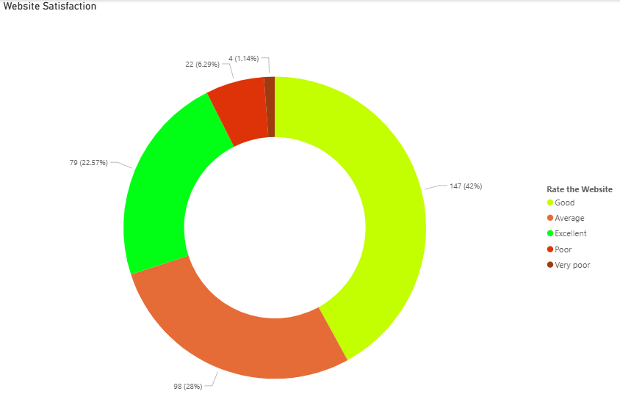
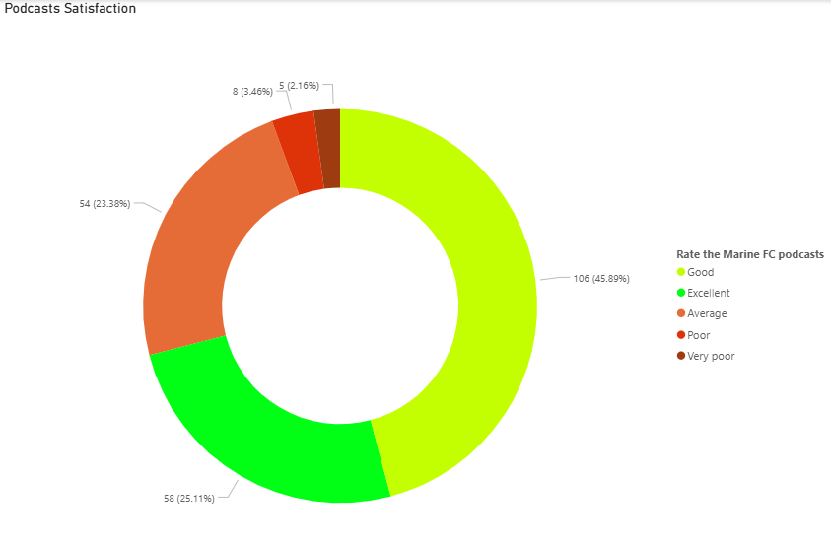
Additional media satisfaction
Respondents have indicated that there are improvements desired from the website but are generally happy with the podcasts.
Website
Podcasts
Satisfaction with the website is currently low at 65%.
Satisfaction with the Marine AFC Podcasts is higher at 71%.

Slide 14
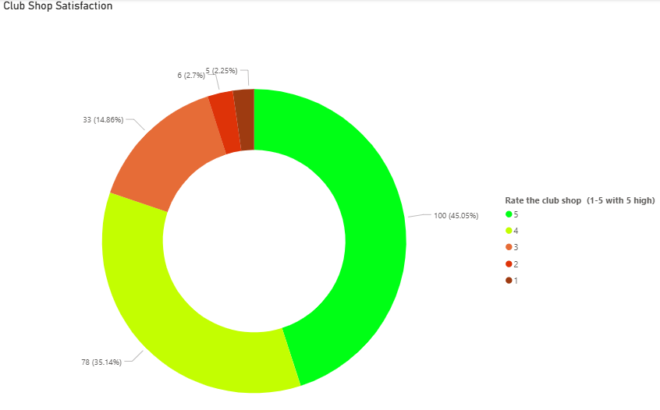
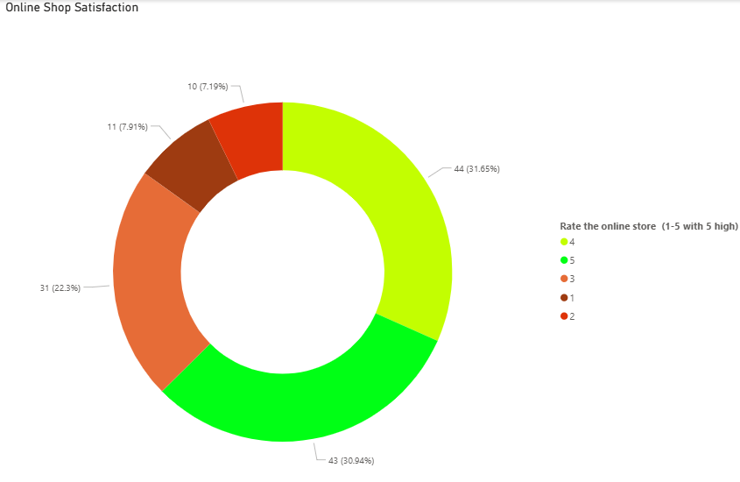
Retail satisfaction
An important note is that the below figures only capture those who have purchased anything from the stores, feedback indicates many others were put off by other factors, as a result satisfaction may be artificially high on this count.
Club Shop
Online Store
Satisfaction with the club shop is currently steady at 75%.
Satisfaction with the online store is lower at 63%.

Slide 15
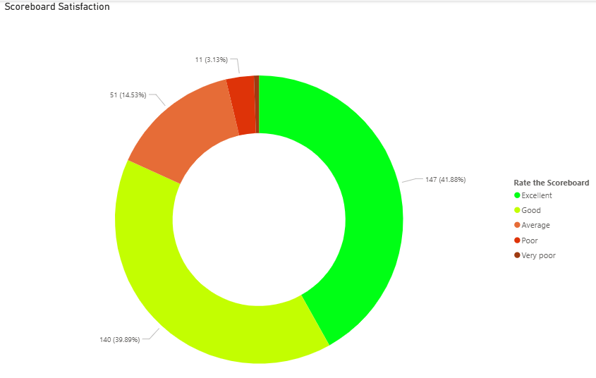
Additional satisfaction
An important note is that the below figures only capture those who have purchased anything from the stores, feedback indicates many others were put off by other factors, as a result satisfaction may be artificially high on this count.
Scoreboard
Satisfaction with the new scoreboard is currently relatively high at 82%.

Slide 16

Additional feedbACK

Slide 17
Club Shop feedback
59 fans gave feedback on the online and in-person club stores with the key findings below:
3 times as many negative feedback points as positive feedback points.
People most disappointed in Opening Times and Online Postage.
18 respondents suggested merchandise they'd like.
Several respondents indicated a desire for a larger range of sizes and women's options.
On a positive perspective, 7 respondents were happy with the quality of the Malooka Merchandise.

Slide 18
Club media feedback
89 fans gave feedback on aspects ranging from social media to game day media:
Nearly 2 times as many negative feedback points as positive feedback points.
Respondents are very keen to get more content than is currently on offer.
The most frequent negative complaint was to do with the PA System.
14 respondents suggested content they'd like.
Comments around the music were frequent with a call for a vote on walk-out music and comments around the volume.
On a positive perspective, 17 respondents were happy with the quality of the current media offering.

Slide 19
Programme feedback
54 fans gave feedback on their matchday experience with the below key findings:
Encouragingly, 51 respondents have indicated that they would want to receive more content in the programmes/online.
Profiles and interviews across the club from players, staff, directors and fans have been requested.
This ties in with a desire to be more connected with the club.
There have also been requests for better accessibility.

Slide 20
Ticketing feedback
60 fans gave feedback on ticketing with topics ranging from pricing to organisation:
Nearly 3 times as many positive feedback points as negative feedback points.
Respondents are generally happy with the current pricing structure however there is a theme of roughly 13 respondents saying the current price mark is the maximum they'd be happy to pay.
The most frequent negative complaint was to do with the PA System.
Youth ticketing came up frequently with calls to allow owners of season tickets to add-on a junior to take the match with them. The new system could otherwise see parents/guardians penalised for not wanting to buy an extra adult ticket to obtain kids' tickets.
Several respondents have asked for reserved seating options for season ticket holders adding that it would allow them the chance to buy drinks.
Respondents seemed happy with the variety of pricing structures including flexi tickets.

Slide 21
Satisfaction rankings
Below is a table showing the ranking of satisfaction by area.
Area | Satisfaction | RAG
Satisfaction with Ticket Pricing | 96%
Satisfied with Programme Price | 96%
Overall Satisfied | 91%
Satisfaction with Match Day Social Media | 86%
Satisfaction with Radio Commentary | 83%
Satisfaction with Post Match Videos | 82%
Satisfaction with Scoreboard | 82%
Satisfaction with non-Match Day Social Media | 82%
Satisfaction with Bistro Drinks | 81%
Satisfaction with Club Shop | 80%
Satisfied with Programme Content v Adverts | 71%
Satisfaction with Podcasts | 71%
Satisfaction with Website | 70%
Satisfaction with Bistro Food | 67%
Satisfaction with Stadium Food | 65%
Satisfaction with In-Stadium Music | 64%
Satisfaction with Online Shop | 63%
Satisfaction with Stadium PA | 59%
Satisfaction with Stadium Drinks | 56%
RAG Ranking:
90%+ - Green
80%-90% - Amber
Below 80% - Red

